Slide 1
Tabulation Method
The Quine-McCluskey Method

Slide 2
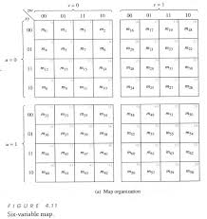
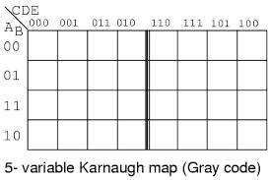
K-map going big!
6 variable k-map

Slide 3
K-map works well upto 4 variable, but when number of variable is more than that trouble starts as it gets difficult to recognize patters leading to wrong selection
Quine McCluskey method or the tabulation method is more systematic and works well for any number of variable

Slide 4
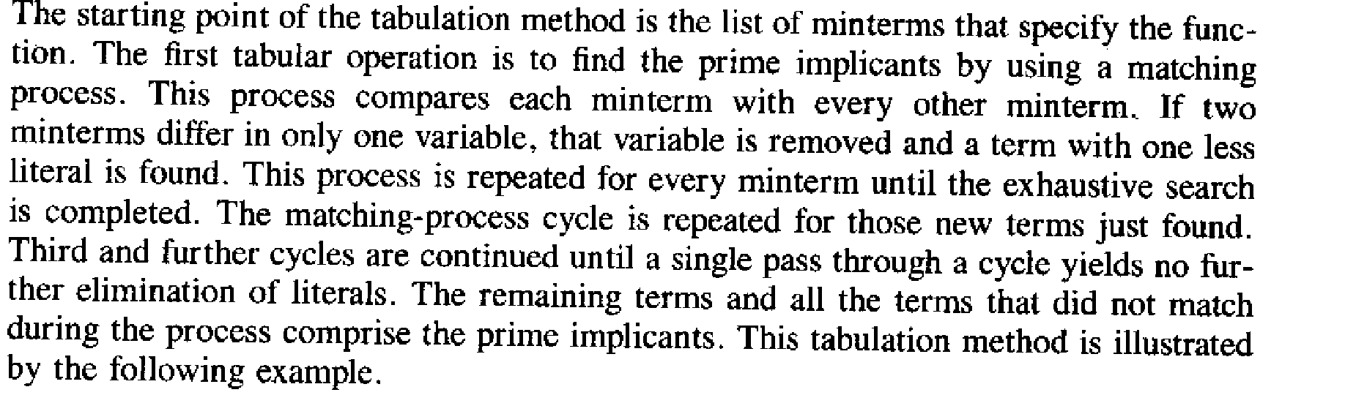

Slide 5
Part 1:Determination of the prime implicant
Forming the tabulation method

Slide 6
Example
F(w,x,y,z)=∑(4,1,7,6,9,8,11,15,10)
Step 1: group the minterms based on the no. of ‘1’s in them Group A: single ‘1’: {0001,0100,1000} Group B: two ‘1’s: {0110,1001,1010} Group C: three ‘1’s: {0111,1011} Group D:four ‘1’s: {1111}

Slide 7
 | Step 1
1 | 0001
4 | 0100
8 | 1000
6 | 0110
9 | 1001
10 | 1010
7 | 0111
11 | 1011
15 | 1111

Slide 8
Step 2: Any 2 minterm that differ by 1 variable is combined and the different variable is removed.The minterms of a group is compared with minterms of immediate next group (this is because 2 term differing by more than 1 bit cannot match). If 2 matching minterms are found, a ‘√’ (tick) is place besides them

Slide 9
 | Step 1 | Step 2
1 | 0001 | (1,9) | _001
4 | 0100 | (4,6) | 01_ 0
8 | 1000 | (8,9) | 100_
 |  | (8,10) | 10_0
6 | 0110 | (6,7) | 011_
9 | 1001 | (9,11) | 10_1
10 | 1010 | (10,11) | 101_
7 | 0111 | (7,15) | _111
11 | 1011 | (11,15) | 1_11
15 | 1111

Slide 10
Step 3:
Terms from step 2 has 3 options. ‘1’ means variable is unprimed, ‘0’ means variable is primed and ‘_’ means variable is not included in the term.
Now compare terms only if they have ‘_’ in the same position. Once two term match place a ‘√’ beside each

Slide 11
 | Step 1 | Step 2 |  |  | Step 3
1 | 0001 | √ | (1,9) | _001 |  | (8,9,10,11) | 10_ _
4 | 0100 | √ | (4,6) | 01_ 0 |  | (8,9,10,11) | 10_ _
8 | 1000 | √ | (8,9) | 100_ | √
 |  |  | (8,10) | 10_0 | √
6 | 0110 | √ | (6,7) | 011_
9 | 1001 | √ | (9,11) | 10_1 | √
10 | 1010 | √ | (10,11) | 101_ | √
7 | 0111 | √ | (7,15) | _111
11 | 1011 | √ | (11,15) | 1_11
15 | 1111 | √

Slide 12
Prime Implicant
The remaining term ( those without ‘√’) in Step 2 and the terms from Step 3 are called the prime implcants. These terms are candidates suitable for forming the simplified form of the expression
Here prime implicants are:
(1,9) | _001 | X’Y’Z
(4,6) | 01_0 | W’XZ’
(6,7) | 011_ | W’XY
(7,15) | _111 | XYZ
(11,15) | 1_11 | WYZ
(8,9,10,11) | 10_ _ | WX’

Slide 13
Part 2 (Optimization): Selection of prime implicants- the setup
Optimization Phase - Optimizing the tabular method

Slide 14
Optimization Phase
 | 1 | 4 | 6 | 7 | 8 | 9 | 10 | 11 | 15
X’Y’Z | X |  |  |  |  | X
W’XZ’ |  | X | X
W’XY |  |  | X | X
XYZ |  |  |  | X |  |  |  |  | X
WYZ |  |  |  |  |  |  |  | X | X
WX’ |  |  |  |  | X | X | X | X
Prime
Implicants
✓
✓
✓
✓
✓
✓
✓
✓
✓

Slide 15
Now, check the circles and write the corresponding terms in SOP format: X’Y’Z + W’XZ’ +
XYZ +
WX’
 | 1 | 4 | 6 | 7 | 8 | 9 | 10 | 11 | 15
X’Y’Z | X |  |  |  |  | X
W’XZ’ |  | X | X
W’XY |  |  | X | X
XYZ |  |  |  | X |  |  |  |  | X
WYZ |  |  |  |  |  |  |  | X | X
WX’ |  |  |  |  | X | X | X | X
✓
✓
✓
✓
✓
✓
✓
✓
✓

Slide 16
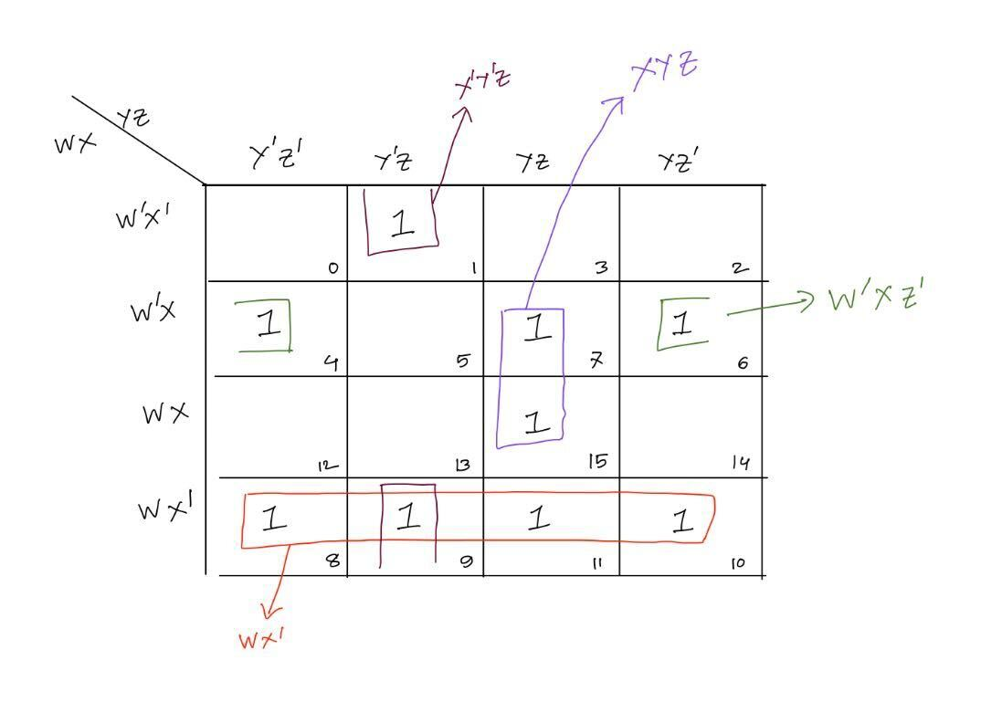
So solution is
F(W,X,Y,Z)= X’Y’Z+W’XZ’+WX’+XYZ
This matches the result from K-MAP done below!
K-MAP using prime implicant shows that it can be further simplified to F(w,x,y,z)= X’Y’Z+W’XZ’+XYZ+WX’

Slide 17
Example 2 (with Don’t Cares)
F(a,b,c,d)=∑m(2,5,6,11,12,14,15)+ ∑d(0,3,4) Note: avoid the don’t care terms in the set-up(optimization) phase.

Slide 18
 | Step 1 | Step 2 |  |  |  | Step 3
0 | 0000 | √ | (0,2) | 00-0 | √ | (0,2,4,6) | 0--0
 |  |  | (0,4) | 0-00 | √ | (0,4,2.6) | 0--0
2 | 0010 | √ | (2,3) | 001- |  | (4,6,12,14) | -1-0
4 | 0100 | √ | (2,6) | 0-10 | √ | (4,12,6,14) | -1-0
 |  |  | (4,5) | 010-
 |  |  | (4,6) | 01-0 | √
 |  |  | (4,12) | -100 | √
3 | 0011 | √ | (3,11) | -011
5 | 0101 | √ | (6,14) | -110 | √
6 | 0110 | √ | (12,14) | 11-0 | √
12 | 1100 | √
11 | 1011 | √ | (11,15) | 1-11
14 | 1110 | √ | (14,15) | 111-
15 | 1111 | √

Slide 19
Optimization Phase - Don’t care terms are avoided here (that’s the only difference).
 | 2 | 5 | 6 | 11 | 12 | 14 | 15
A’D’ | X |  | X
BD’ |  |  | X |  | X | X
A’B’C | X
A’BC’ |  | X
B’CD |  |  |  | X
ACD |  |  |  | X |  |  | X
ABC |  |  |  |  |  | X | X
✓
✓
✓
✓
✓
✓
✓
Answer: A’D’ + BD’ + A’BC’ + ACD

Slide 20
Try it yourself
F(w,x,y,z)=∑(0,1,2,8,10,11,14,15)

Slide 21
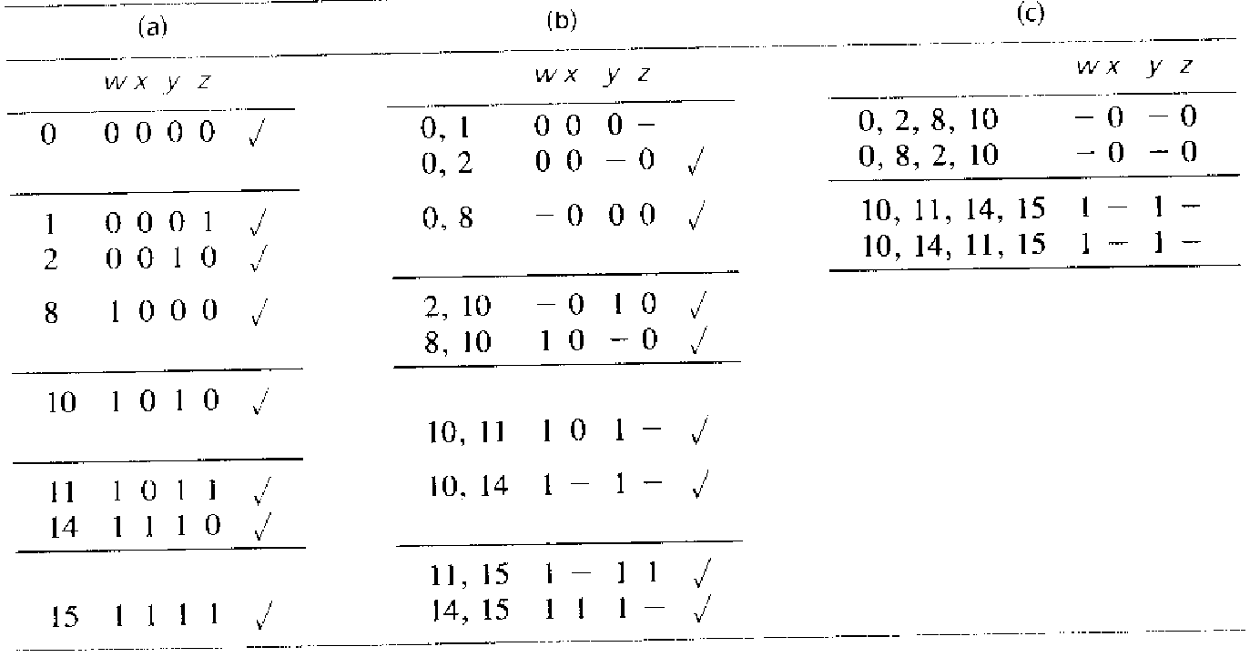
Solution (Part 1)

Slide 22
Optimization Phase – Do it yourself
Final answer:
F=w’x’y’+x’z’+wy

